Slide 1
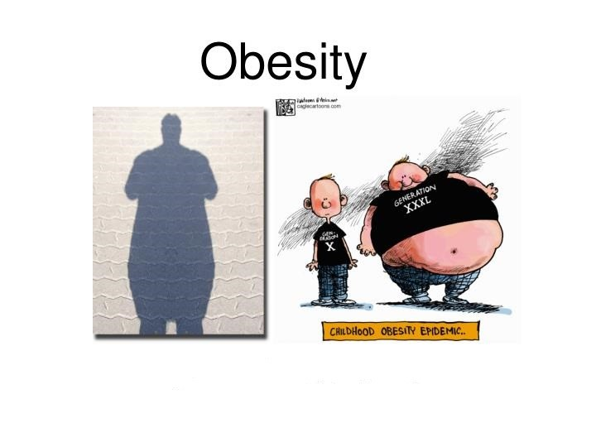
The exploration and research of obesity
Project Information:
We are Obesity Canada, which is Canada’s leading obesity charity, made up of healthcare professionals, researchers, policy makers and people with an interest in obesity. As A growing number of people are suffering from obesity. Our organization decide to find the major causes of obesity through data research and provide some health advice for individuals and help them manage and overcome obesity.
Project Object:
The project will analyze the dataset through the data visualization tool named Tableau. Identify the status and the main causes of obesity. Finally produce health advises for individuals.
Data Set :
Dataset: ObesityDataSet_raw_and_data_sinthetic.csv

Slide 2
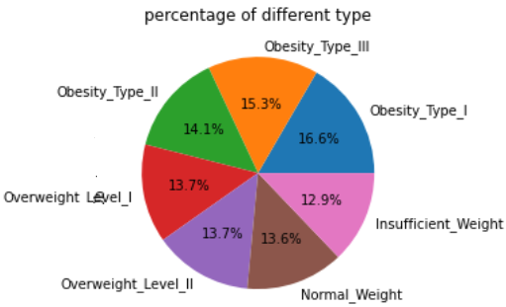
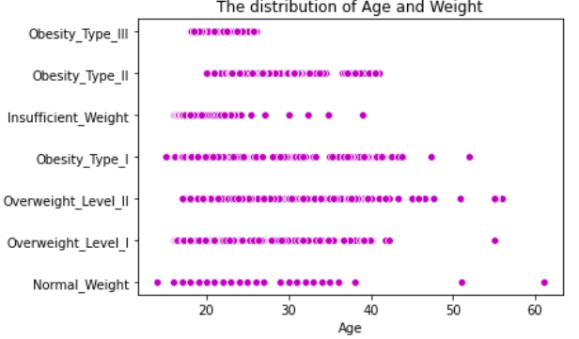
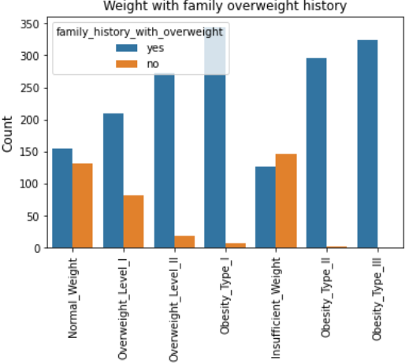
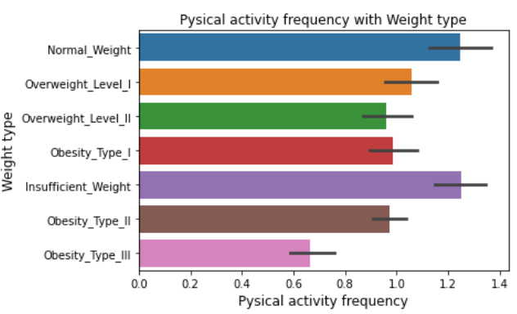
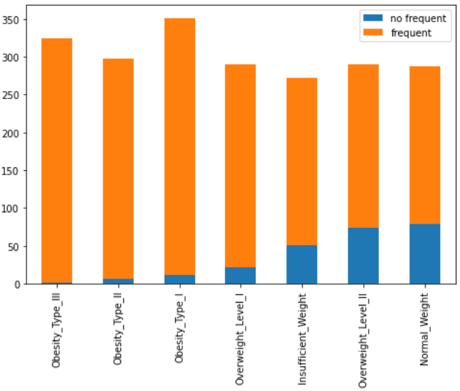
We are facing serious overweight and obesity problem, we need to find main causes and take actions right now!
46% are obese,27.5% are overweight
Many youth are struggle with obesity
Obesity and overweight can affect next generations
High frequent of consumption high caloric food, high risk of obesity
People who suffer obesity has low physical activity frequency

Slide 3
Insights from the research
Problems:
Through the research, we can see people are facing serious overweight and obesity problem, especially youth.
Not only the high present of people are suffering from obesity, but also can affect the next generation.
Obesity has high correlation with frequent of consumption high caloric food and physical activity frequency.
Suggestions:
Pay more attention from youth.
Reduce of frequency of consumption high caloric food
Take more physical activity.

